Slide 1
Personal Branding
On Social Media

Slide 2
Social media is about sparking empathy.
Notes:
Users are scrolling through social for entertainment. What gets their attention is something they can connect to emotionally.

Slide 3
Tips for all social media networks

Slide 4
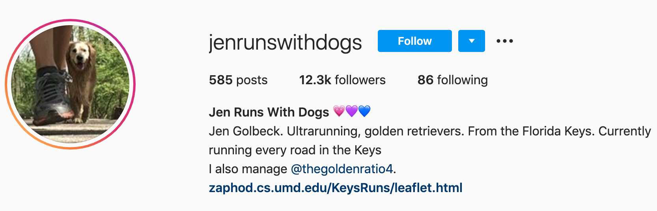
Establish a clear identity

Slide 5
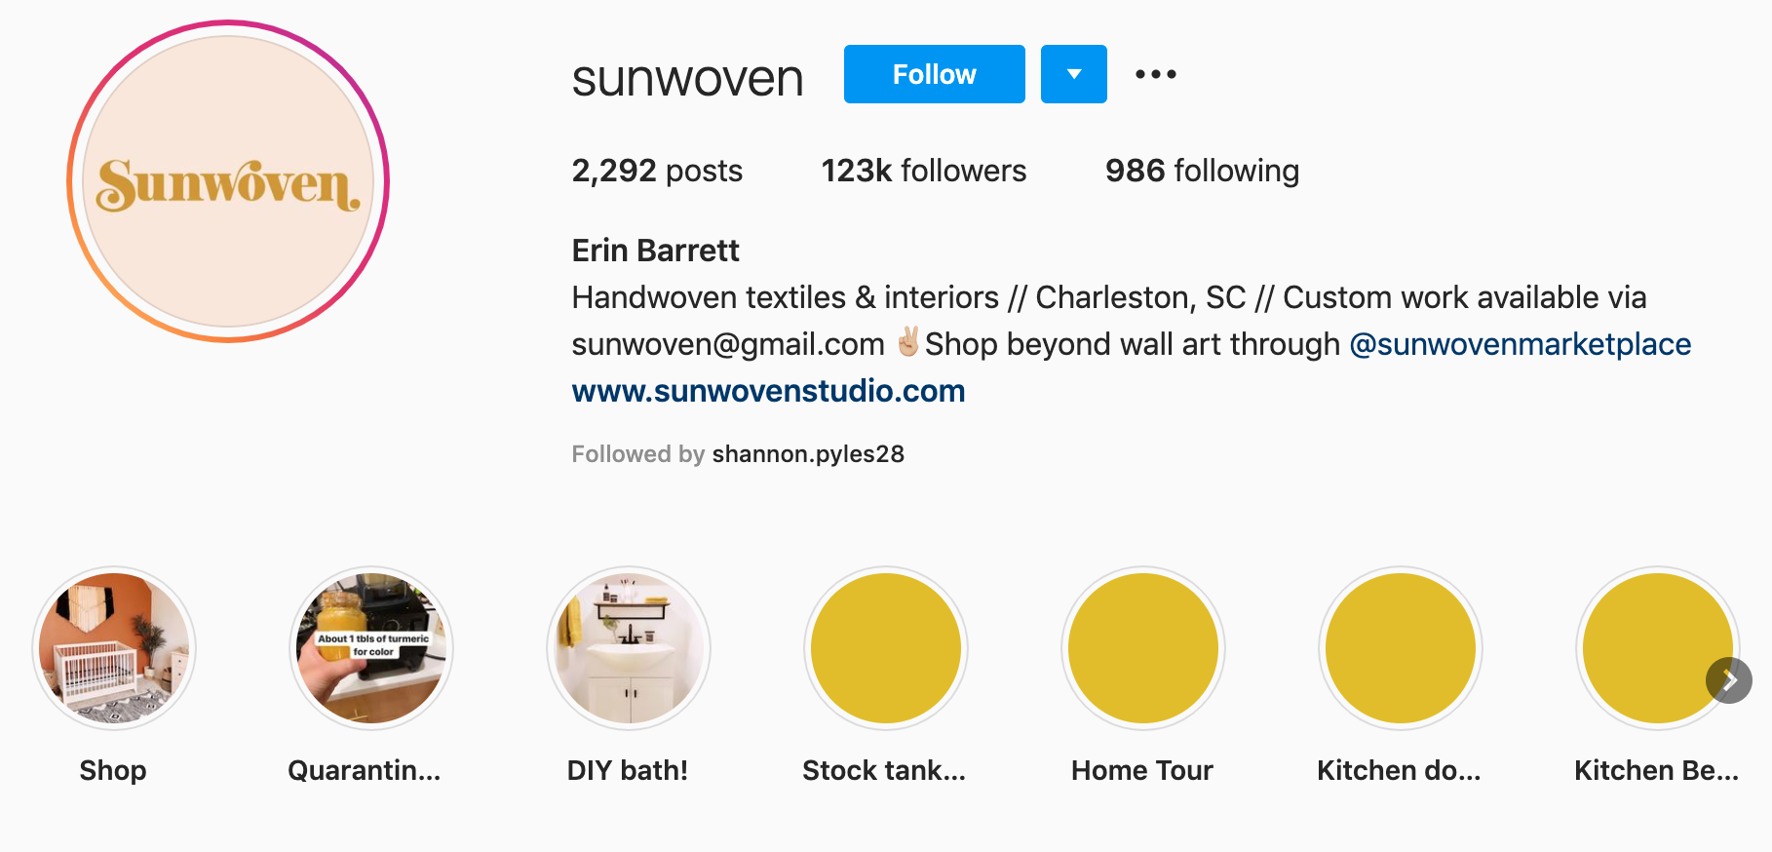
Notes:
Call to action helps.

Slide 6
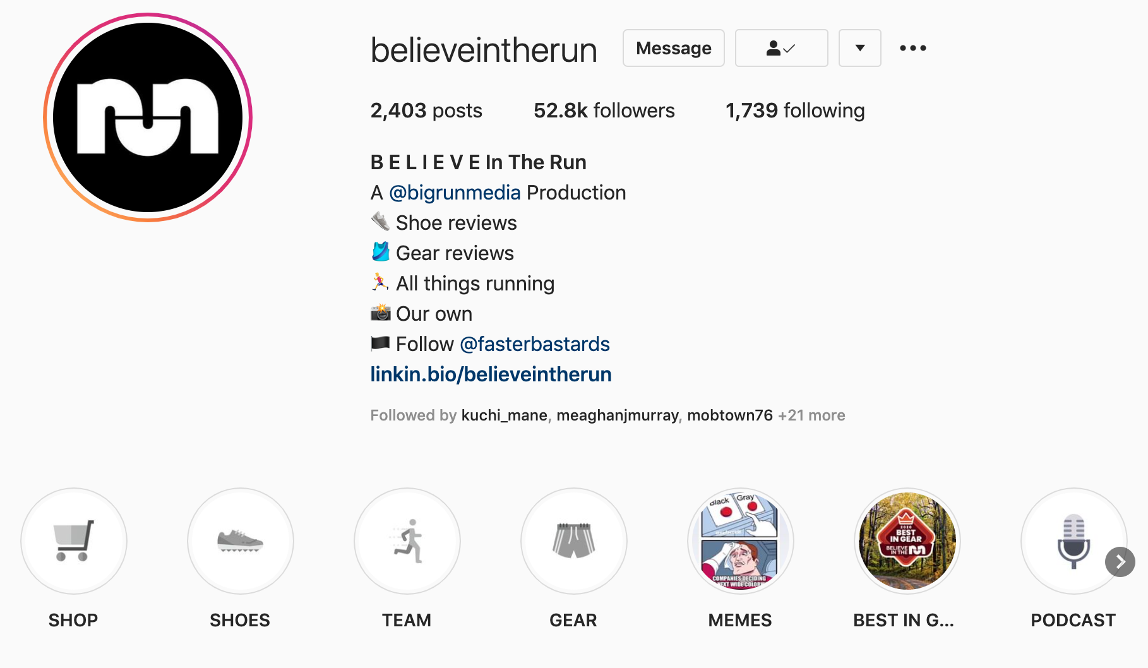

Slide 7
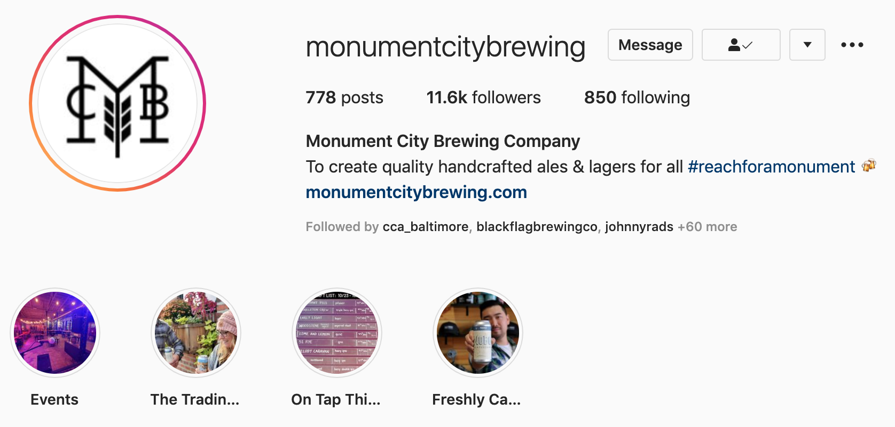
Notes:
A mission statement in the profile makes things extremely clear.

Slide 8


Slide 9


Slide 10
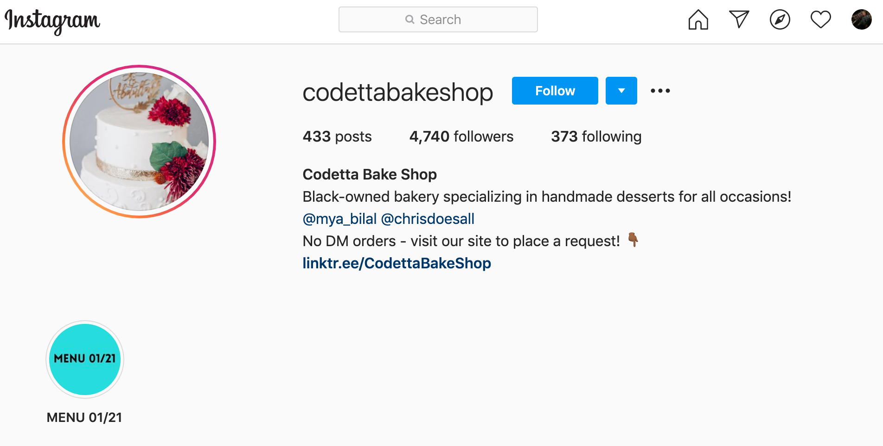
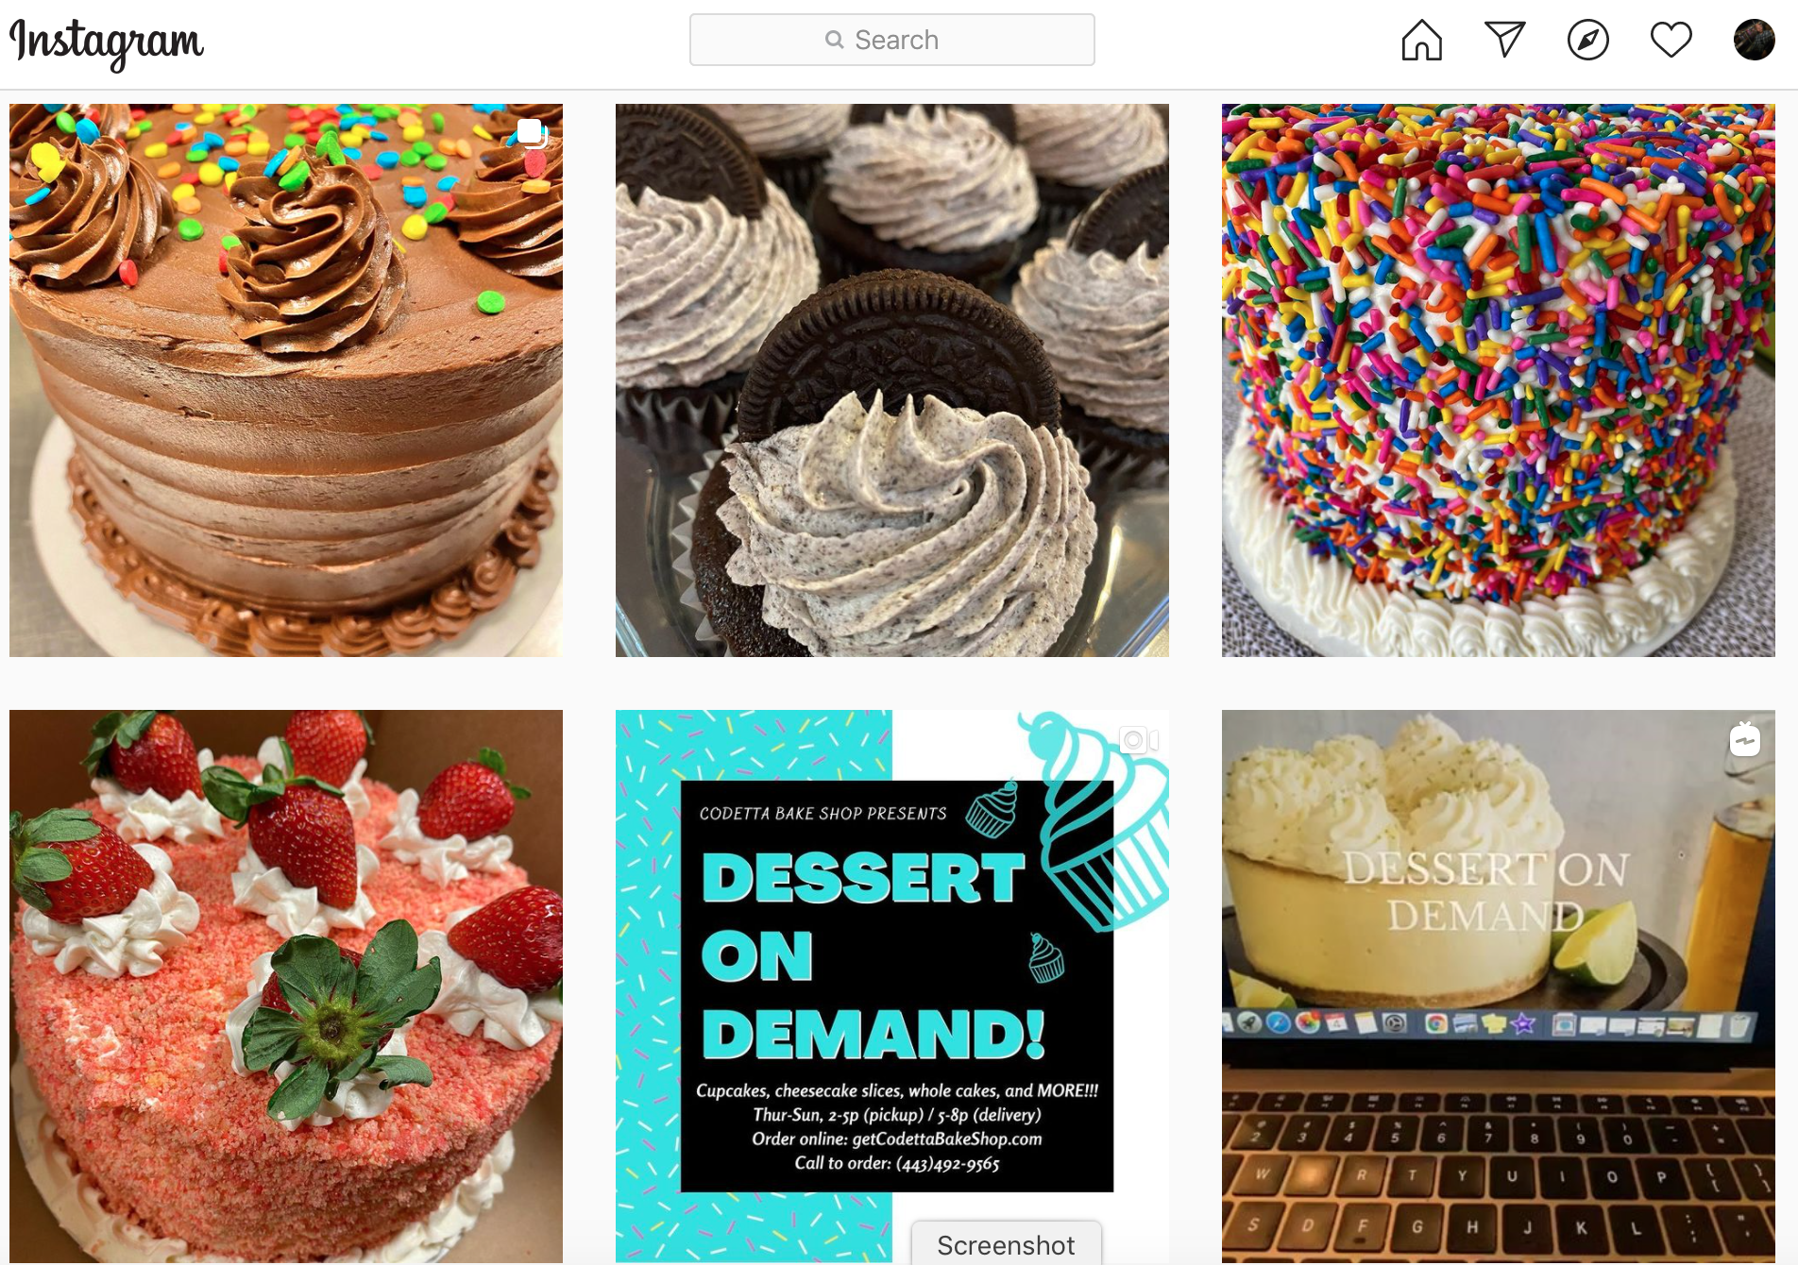

Slide 11

Use your profile
Notes:
Tag accounts you want to associate yourself with. Use clear keywords. Show up in searches.

Slide 12
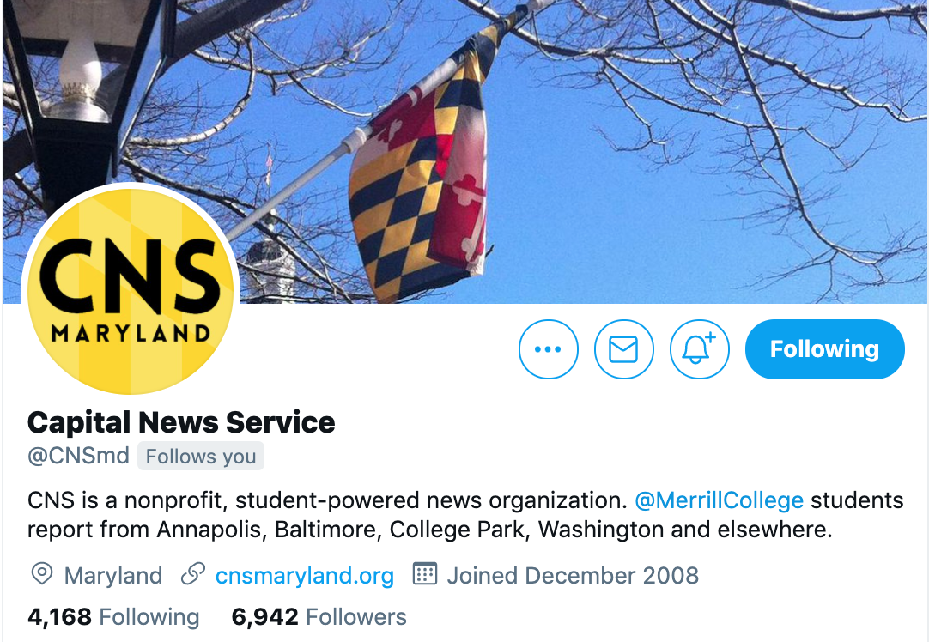
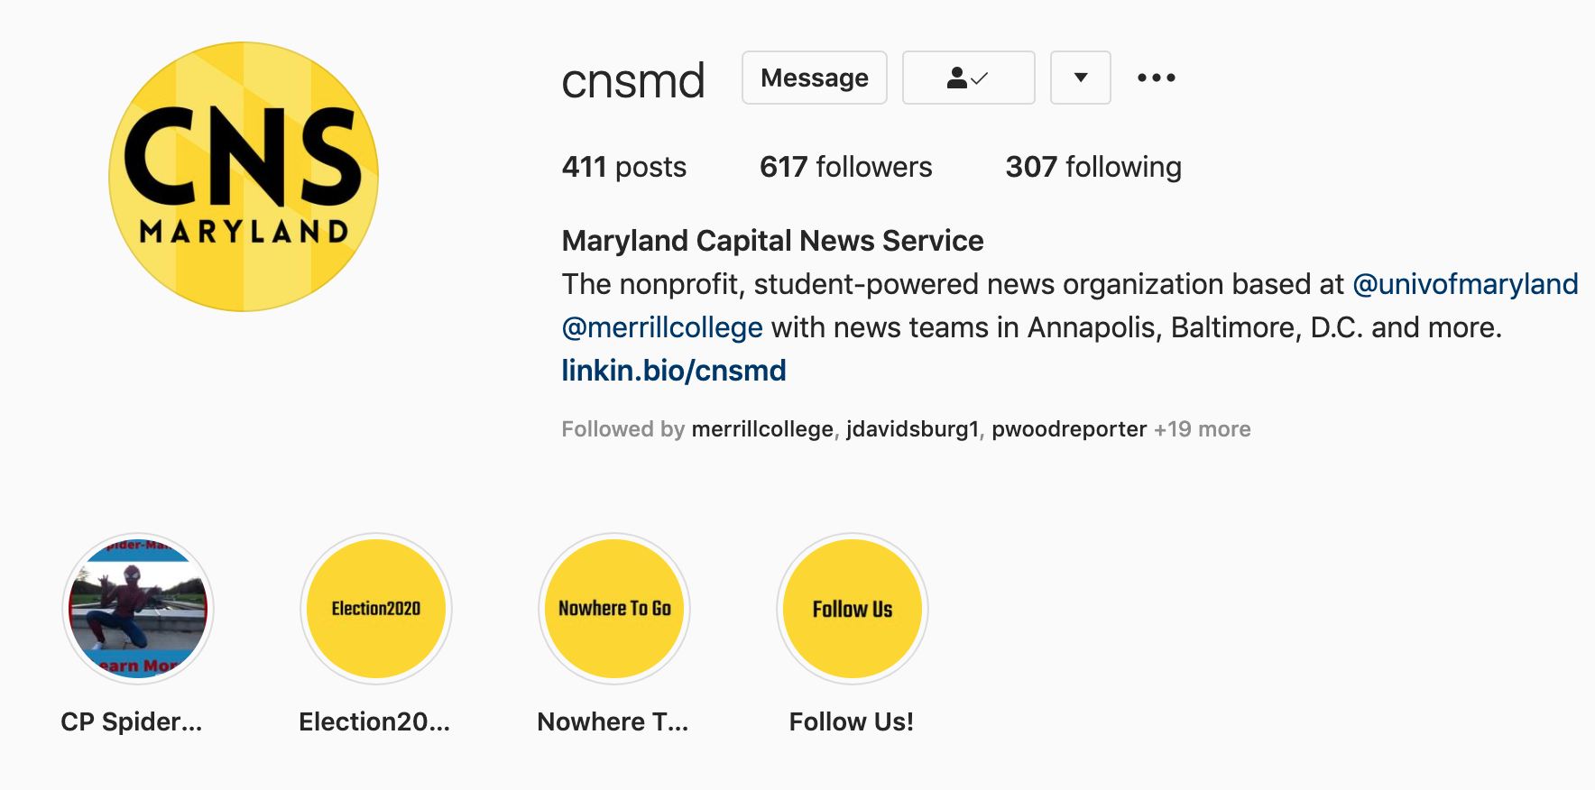
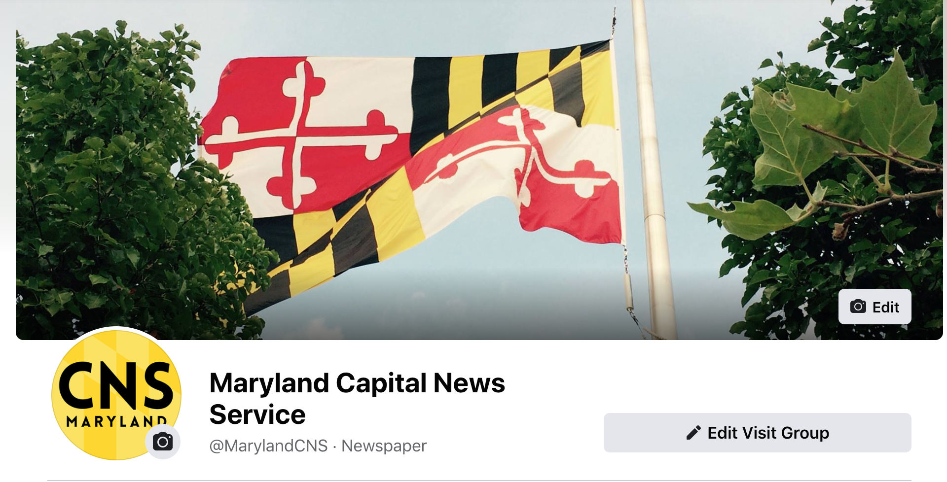

Be Consistent

Slide 13
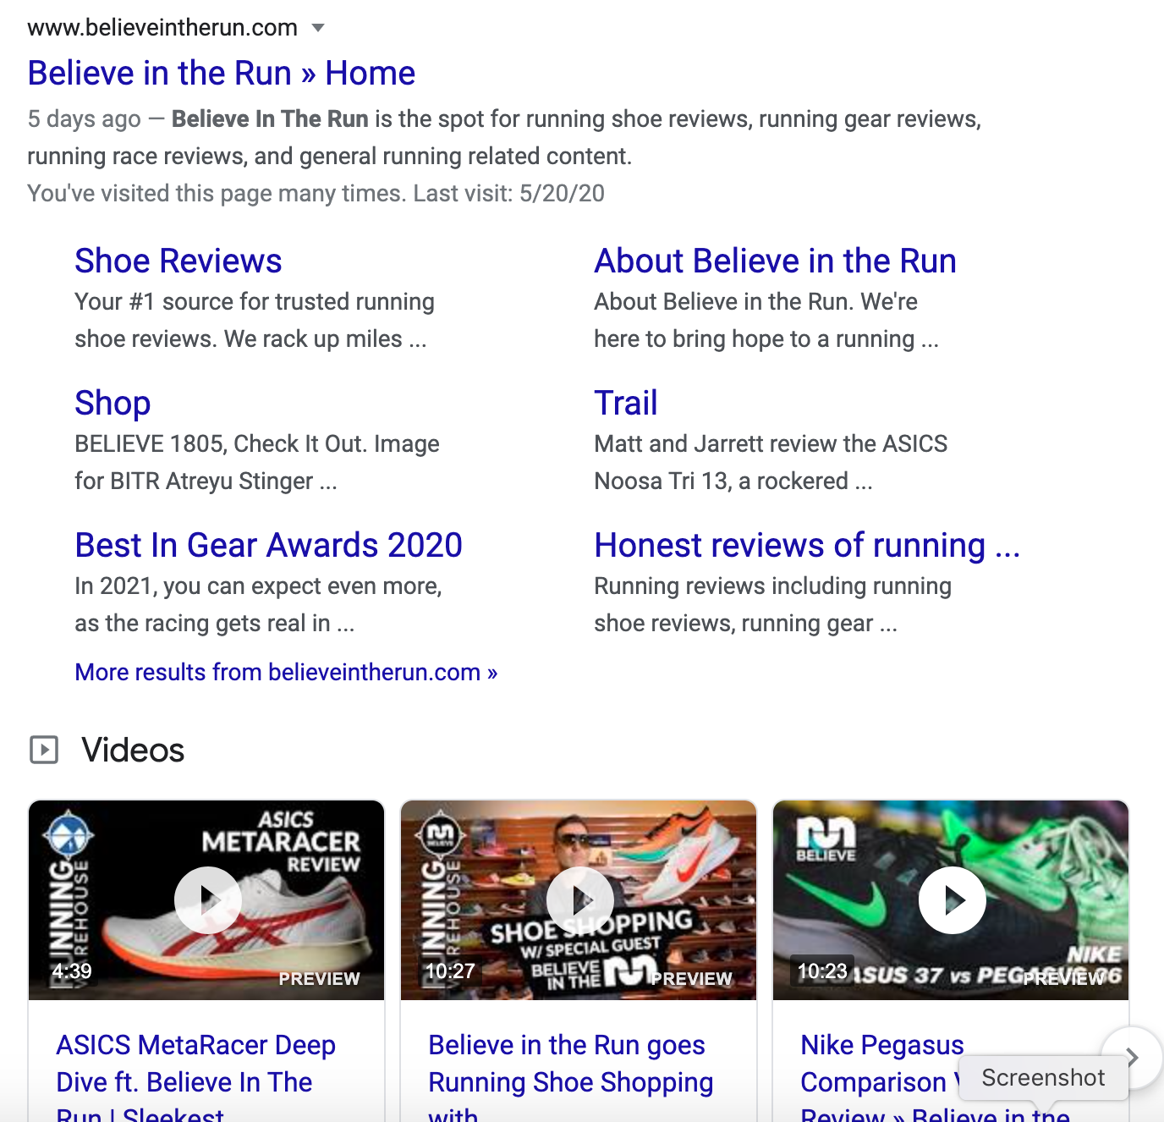
Google Yourself

Slide 14
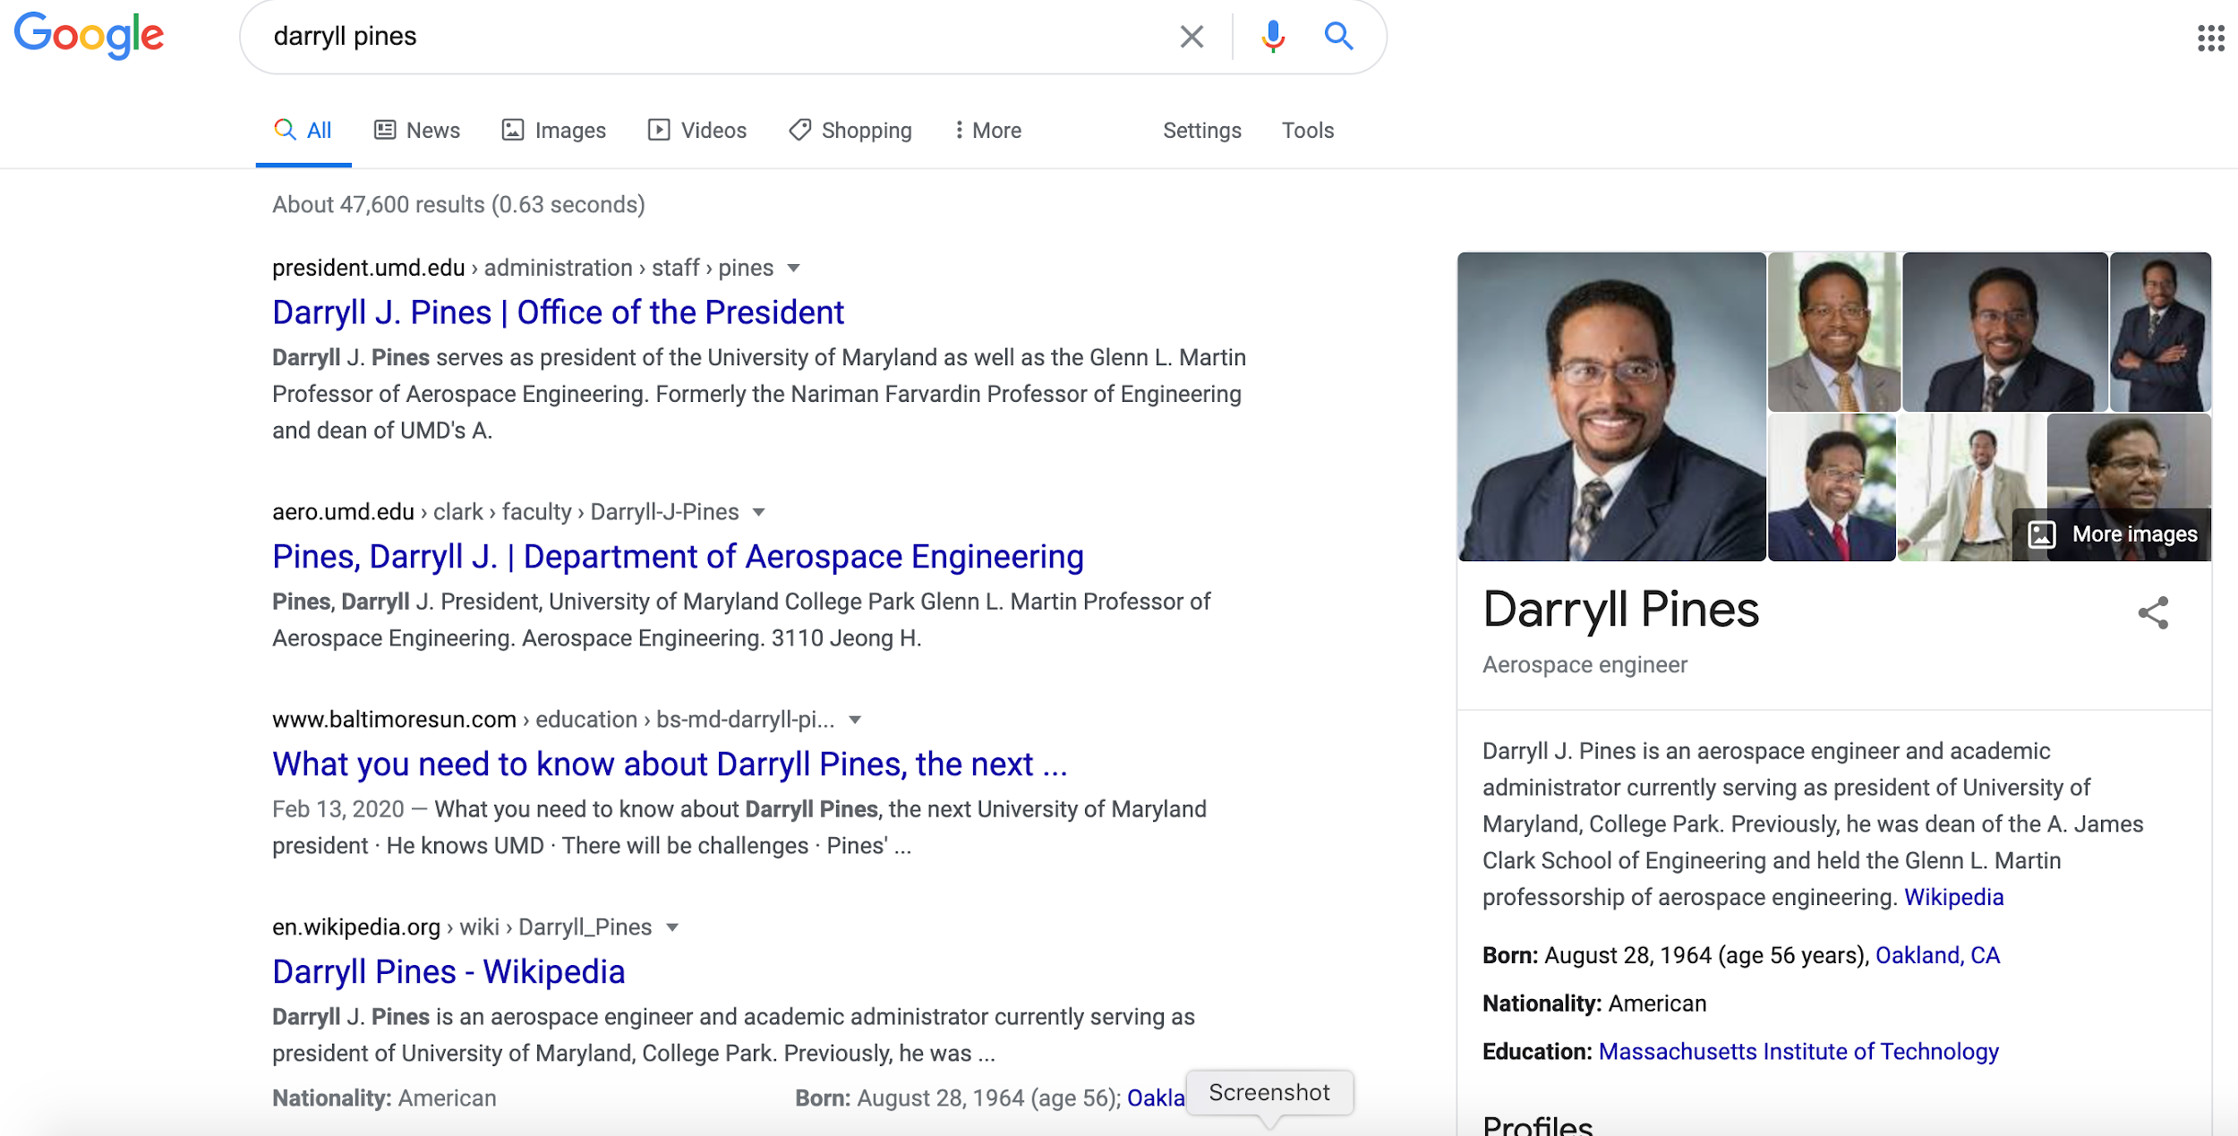
Google Yourself

Slide 15
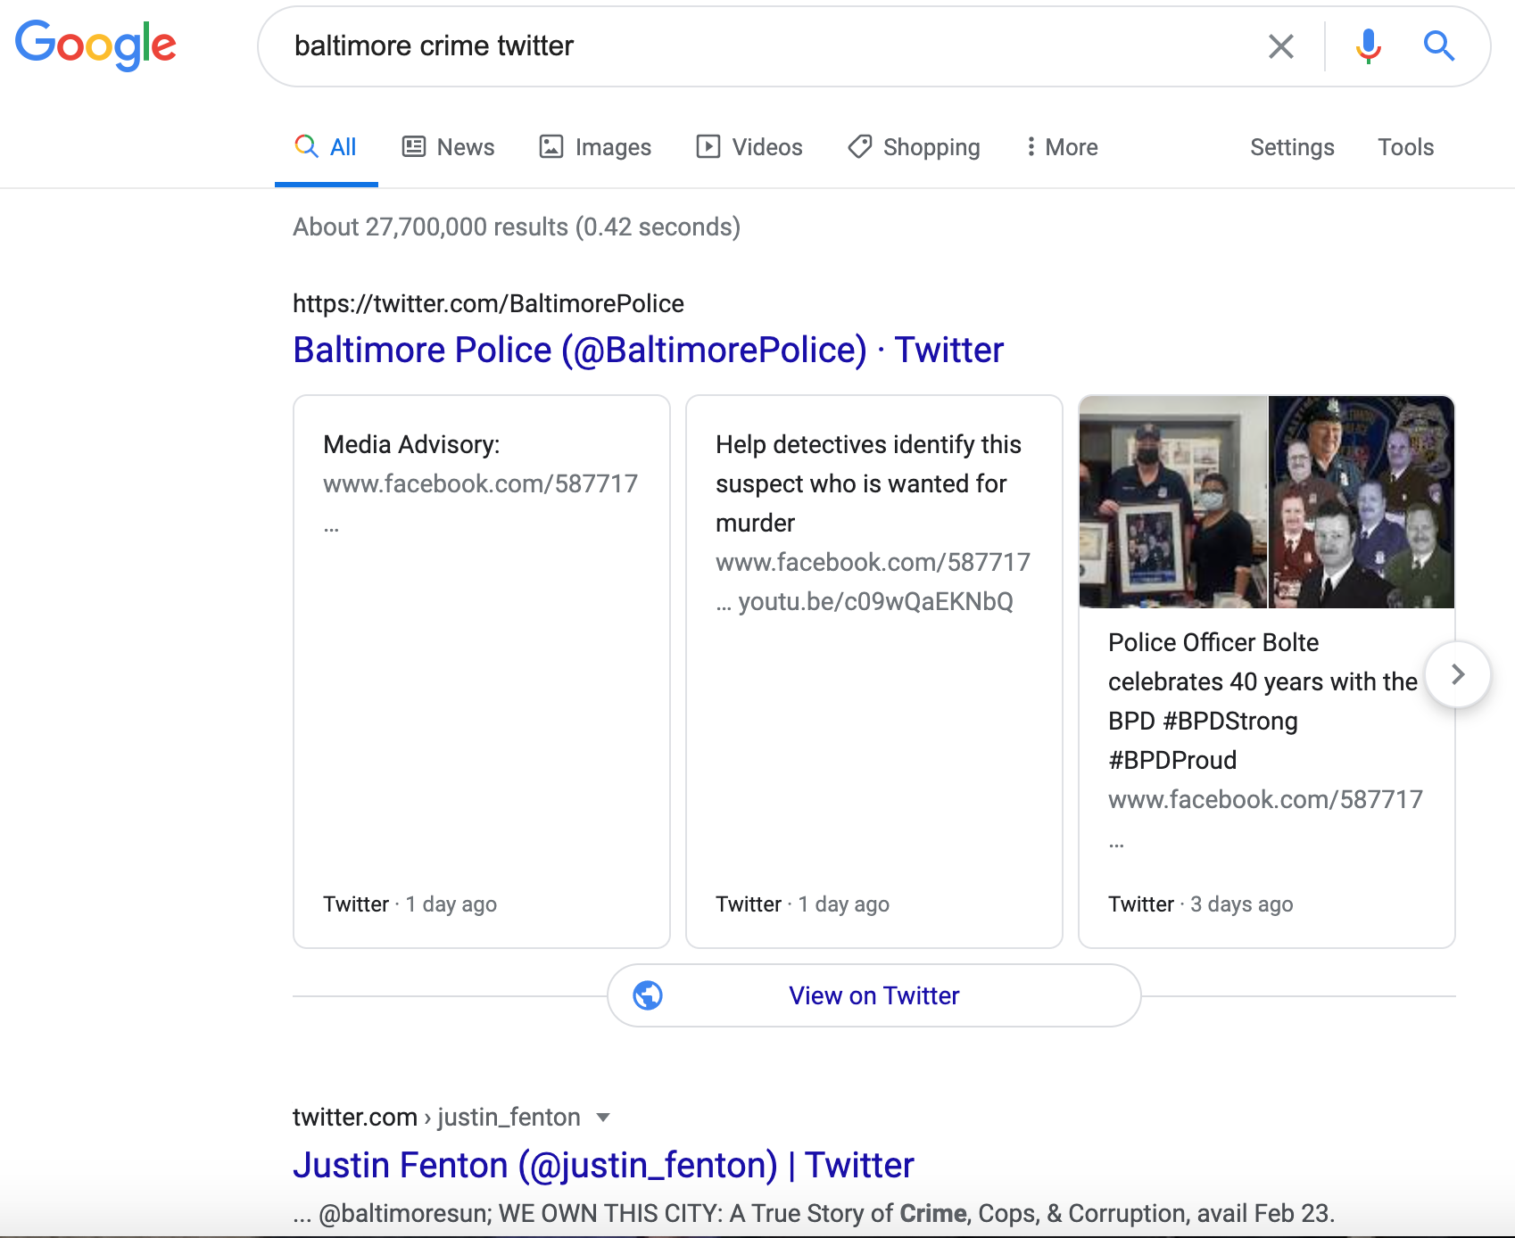
Google Yourself

Slide 16
More Tips
Pick a topic you want to be known for, then lurk your competitors
Live in their comment sections
Don’t be a creep
Ask questions
Answer questions
Experiment and be an early adopter
Consistency

Slide 17
Who is your target audience?

Slide 18
It’s not everyone.

Slide 19
Instagram

Slide 20
Do it all
Reels (sorry, TikTok)
For now ...
Stories (sorry, Snapchat)
Pictures (sorry, only good part of Facebook)
That’s why Zuckerberg bought ‘em
Notes:
Don’t forget to add value with captions on your posts. Captions have shown to increase engagement. News organizations like The Washington Post, with a highly successful IG strategy, post long captions and even follow those with story comments.

Slide 21
The Instagram Audience
40% of U.S. adults use this social network
YouTube: 74%
Facebook: 68%
Twitter: 25%
LinkedIn: 25%
Source: Pew Research Center

Slide 22
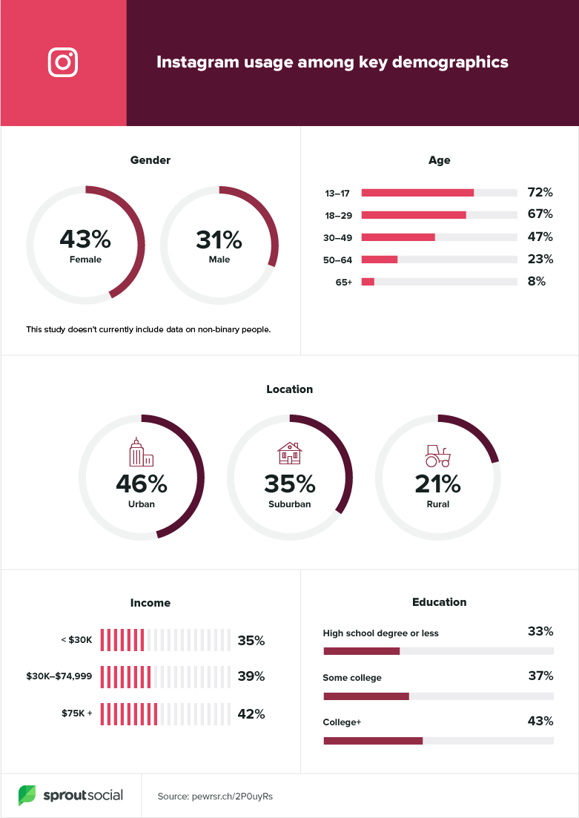
The Instagram Audience
Notes:
Only the Facebook audience is more loyal among the big social media networks.

Slide 23
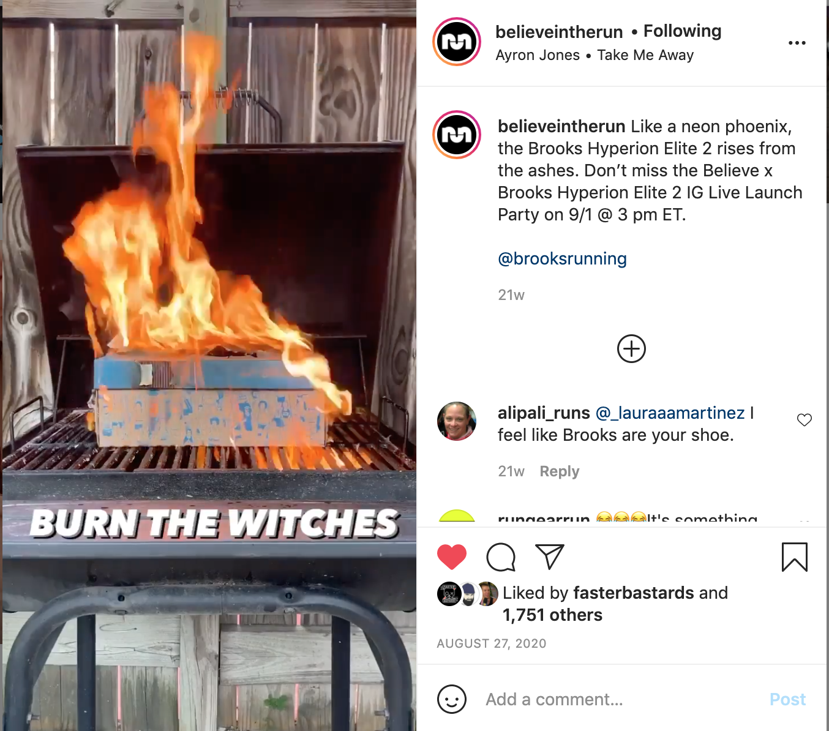
Reels

Slide 24
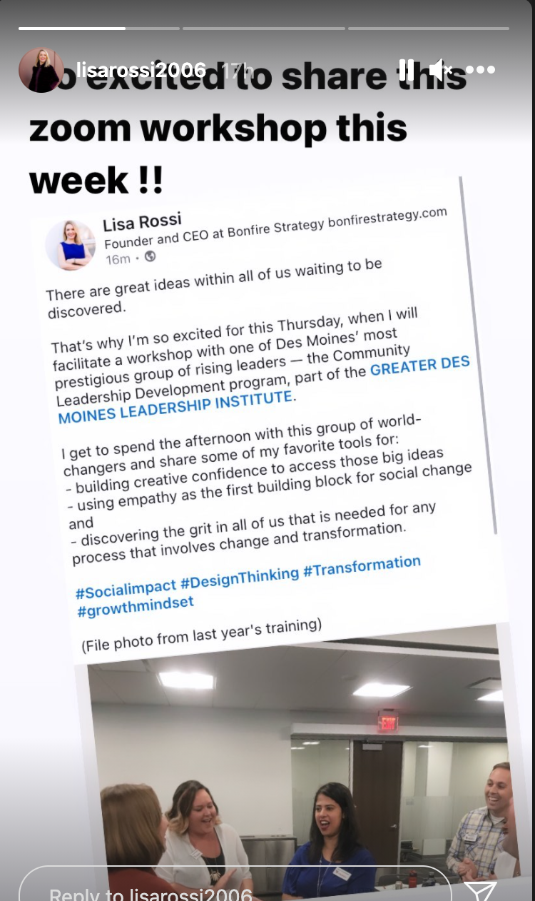
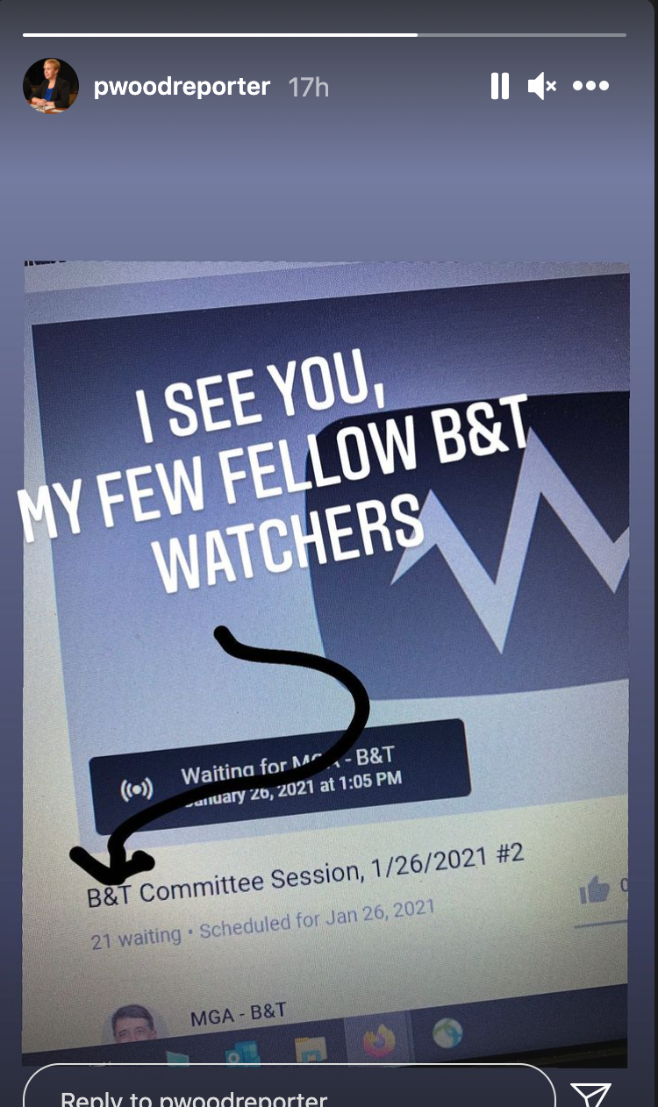
Stories

Slide 25
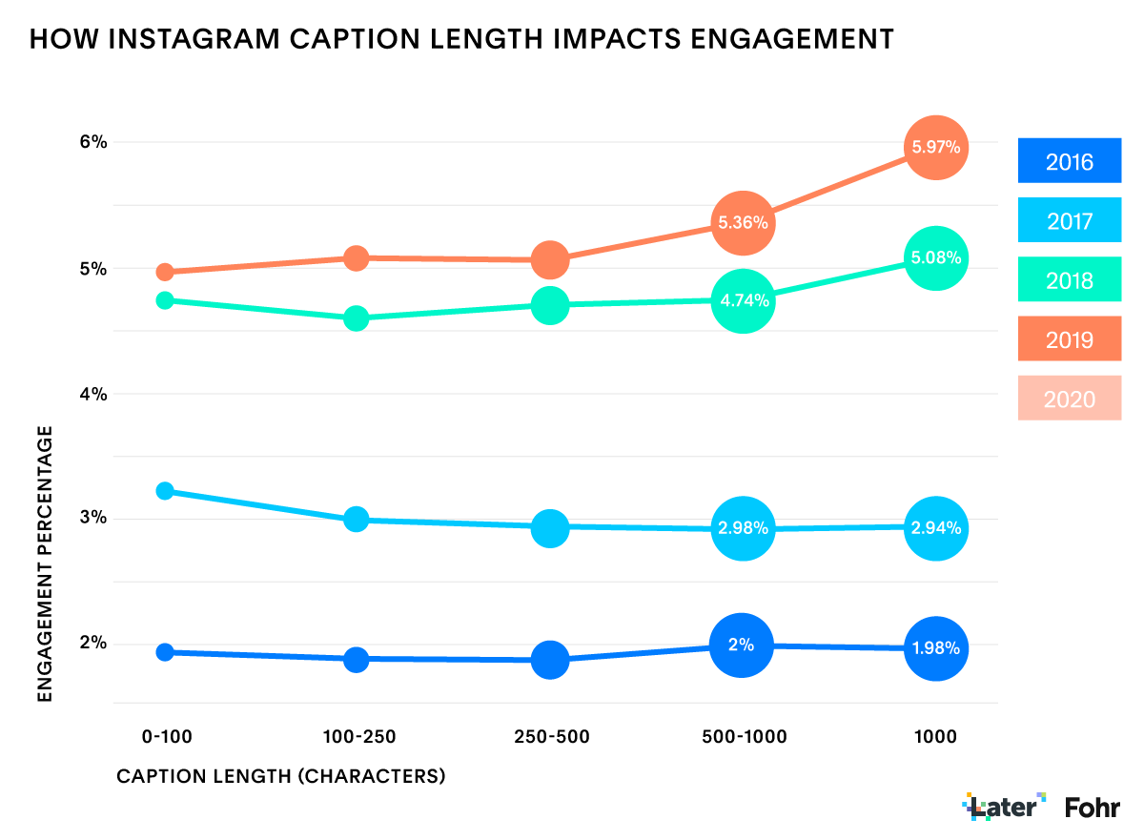
Keep telling the story in the caption (and comments)
Source: Later

Slide 26
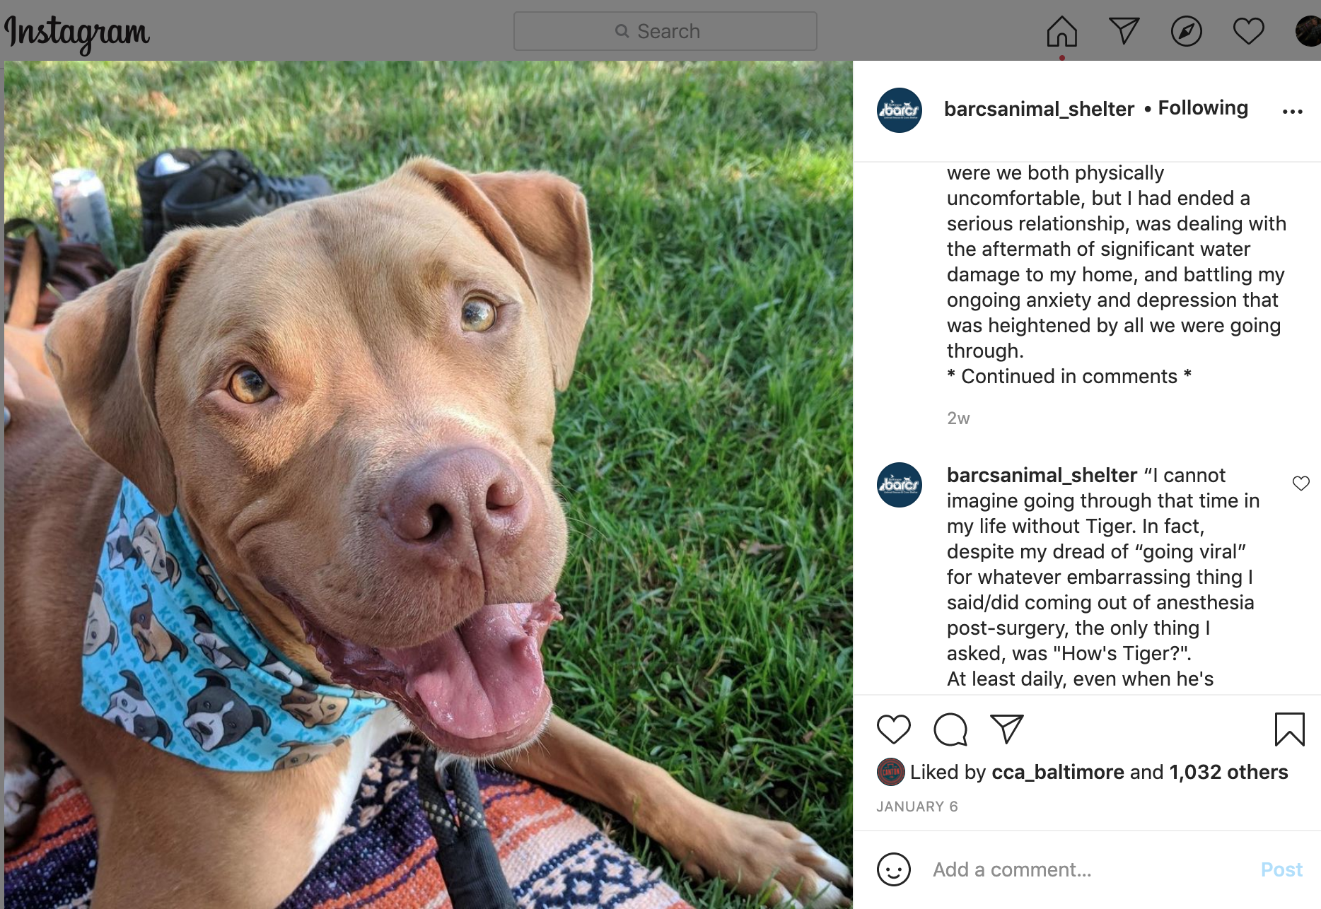
Keep telling the story in the caption (and comments)

Slide 27
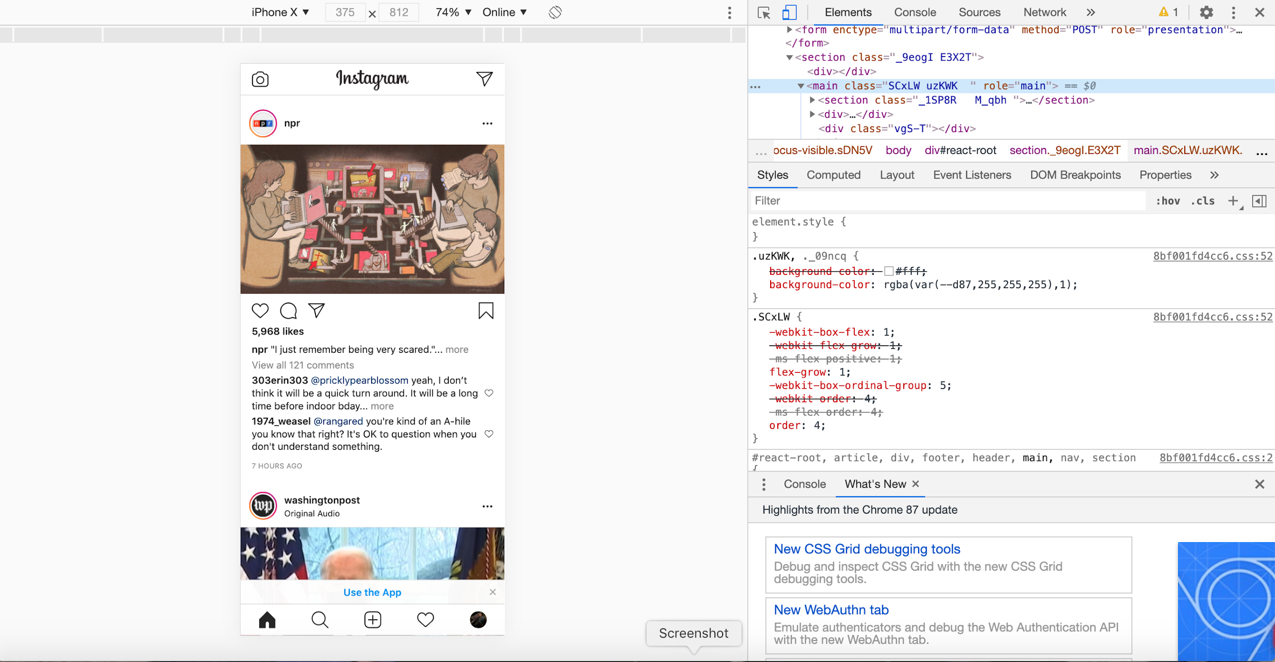
Here’s a Trick: Upload from your desktop

Slide 28

Switch to a professional account
Notes:
Know your audience better.

